Slide 1
Progress in Active Infrared Imaging for Defect Detection in the Renewable and Electronic Industries
Presenter: Jung Wook

Slide 2
目录
Introduction
Key Techniques
01
02
Renewable Industry
Electronic Industry
03
04

Slide 3
Introduction
01

Slide 4
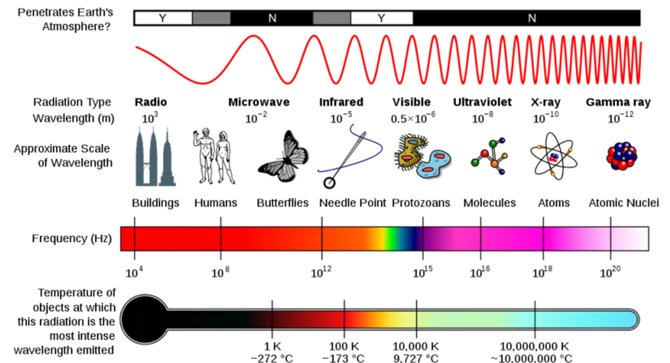
1.Introduction
Any object in nature that is above absolute temperature (−273 ◦C) radiates heat
(electromagnetic waves) outward
Infrared：a wavelength range of
760 nm to 1 mm
The higher the
temperature of an object, the greater the energy radiated
Electromagnetic waves

Slide 5
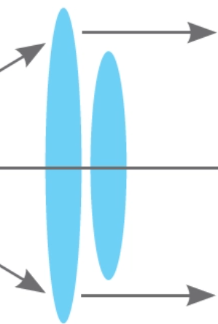
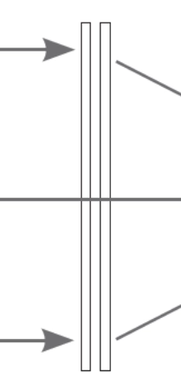
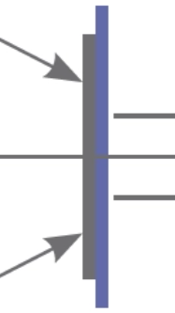
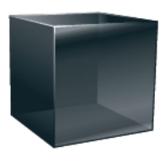

Principle of infrared thermal imaging (IRT) technology
Optical grating
The object
Infrared chart
01
02
03
04
05
Detector
Lens

Slide 6
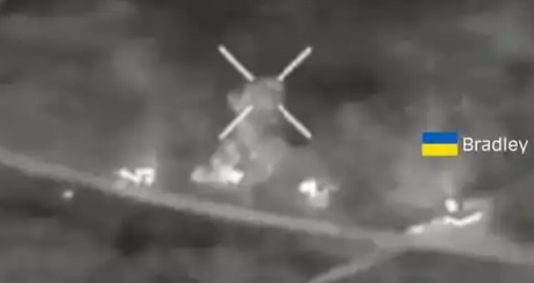
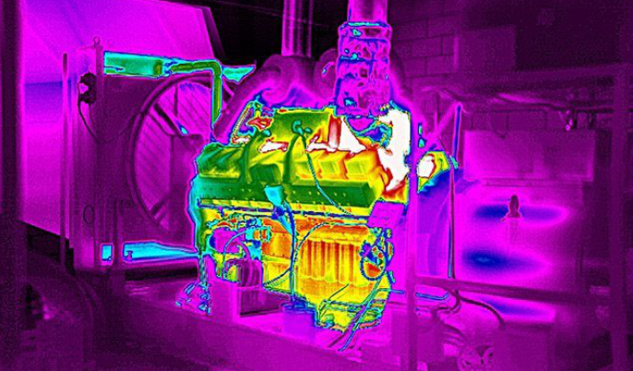
Advantages of IRT technology
01
Non-contact and non-invasive
Test the stability of hazardous materials.
02
High-speed
Fast moving objects can be continuously detected.
03
Relatively safe
Can be used over and over again for the same target.
04
Intuitive and easy-to-understand results
The observation results can directly reflect the problem

Slide 7
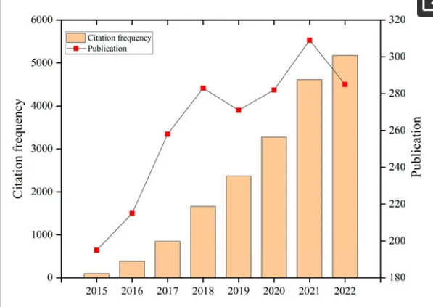
Prospects for development
The citation frequency and number of publications for the keyword “IRT” were searched for in Web of Science
This upward trend suggests the increasing significance of IRT across various academic disciplines, motivating researchers to delve deeper into the applications and advancements of IRT technology.
This is distinctly demonstrated in the chart, providing robust support and impetus for current and future IRT research.

Slide 8
Key Techniques
02

Slide 9
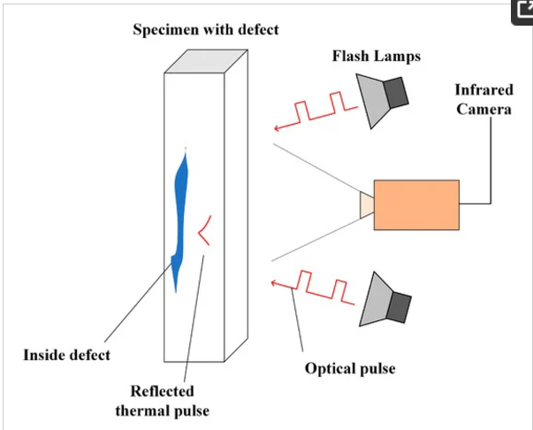

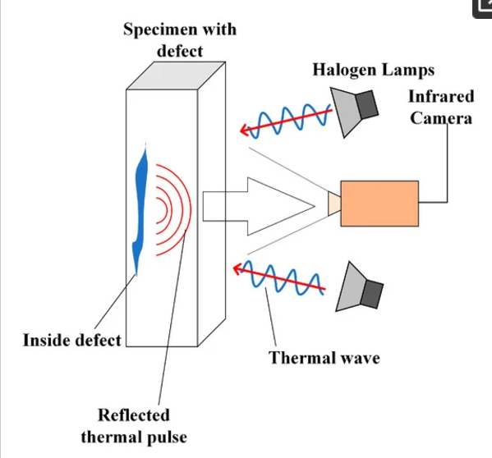

2.1 PT AND LT
Schematic of PT tests in the defect detection process
Infrared Camera→A thermal pulse is emitted to the sample→
Fast infrared camera records images→
The computer uses algorithms to create images
Schematic of LT tests in the defect detection process
The signal generator generates heat waves→
The infrared camera captures the thermal reaction of the sample→
The analysis results determine the defect location.

Slide 10
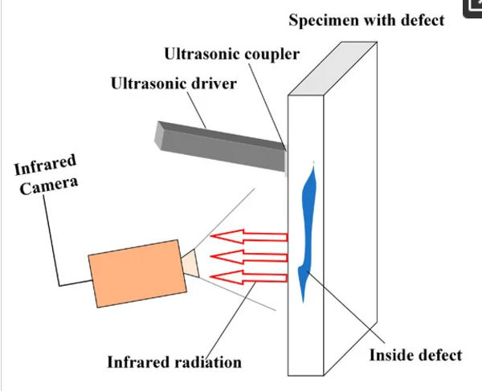
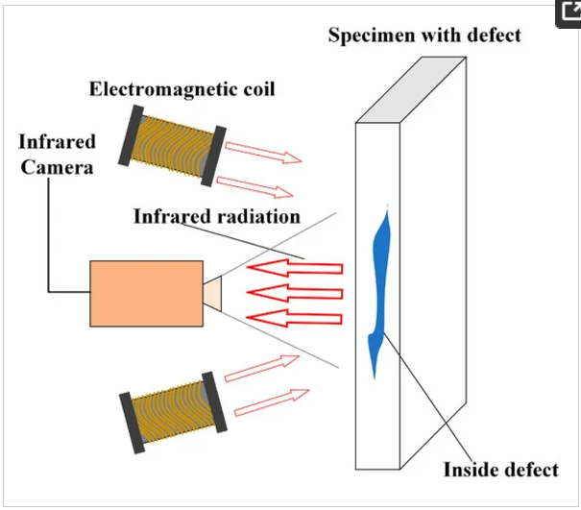
2.2 UVT AND ECT
Schematic of UVT tests in in the defect detection process
The ultrasonic transducer excites the specimen to be detected→
The vibration propagates inside the material, leading to localized heating of cracks through internal friction→
Infrared cameras capture temperature changes
Schematic of ECT tests in in the defect detection process
A coil with pulsed excitation is brought near the test specimen→
Induced eddy currents surround defects or impurities→
Form temperature field distribution

Slide 11
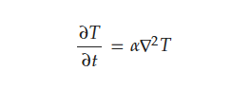
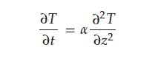
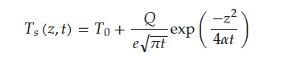
2.3 Classification of thermal imaging techniques
2.3.1 Transient heat transfer
The Fourier diffusion equation
↓
Steady-state heat conduction :
The temperature at each point in the heat transfer process does not change with time, and the heat transfer rate is independent of time.
The heat flow rate remains constant
The one-dimensional heat flow of Equation
↓
Transient heat transfer

Slide 12
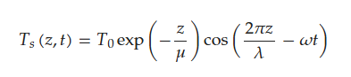
2.3 Classification of thermal imaging techniques
2.3.2 Static heat transfer
Transient heat conduction :
The temperature of each point in the heat transfer process changes with time, and the heat transfer rate is not constant.
An isotropic semi-infinite specimen
𝜔 is the modulated frequency,
𝜆 corresponds to thermal wavelength,
𝑇0 is the initial temperature,
𝜇 is expressed as thermal diffusion length

Slide 13
Renewable Industry
03

Slide 14
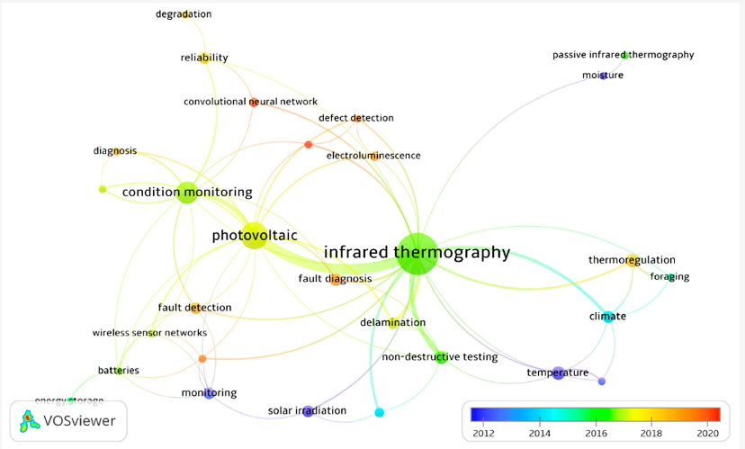
3.1 Photovoltaic solar
Detection Method
1.Old:
Traditional electrical performance testing of PV modules is a mature testing method, but it has limited fault-detection capabilities.
2.New:
Using IRT methods

Slide 15
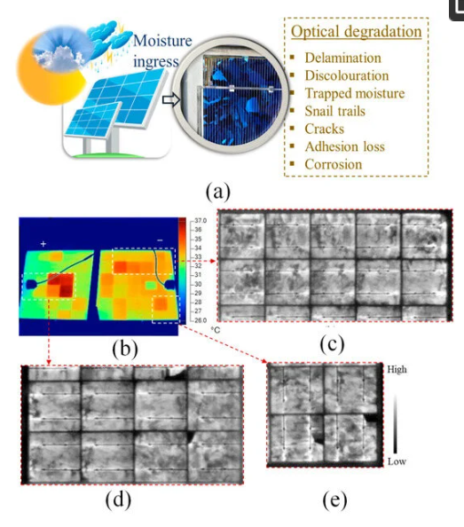
3.2 Optical Degradation
Optical Degradation In PV
1. Causes Of PV Optical Degradation
(1) Water infiltration in the environment causes changes in the structure of the pv panel.
(2) Faulty cells result in mismatch losses, thereby leading to an uneven distribution of cell temperature (Tc) across the PV module.
2. PV Module In The Field:
(a) under environmental stressors e.g., high humidity, temperature, and UV radiation, moisture can enter the PV module ;
(b) IRT characteristics of PV Module X acquired under clear sky outdoor conditions;
(c–e) EL characteristics acquired under Isc bias conditions of the corresponding marked areas in (b) .

Slide 16
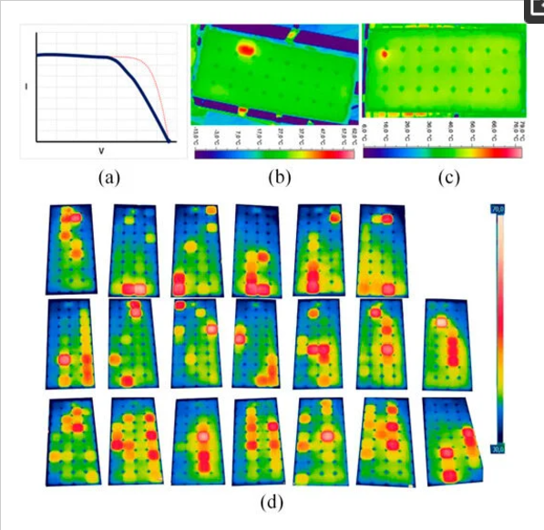
3.3 Electrical Mismatches and Degradation
Electrical Mismatches And Degradation In PV
1. Fault types :
Cell cracks, snail trails, broken interconnecting ribbons and busbars, shunts, and poor soldering.
2. Methods of diagnosing faults :
The measurement of Current–Voltage (I–V) characteristics.
3. PV module in the field:
(a) typical I–V characteristic output . IRT of an electrically mismatched PV module, due to broken interconnection ribbons;
(b) defective soldering/busbar
(c),(d) thermal image of PV module

Slide 17
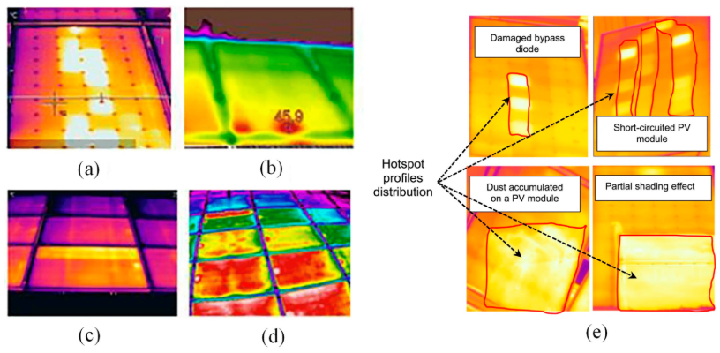
3.4 Non-Classified Faults
Potential-induced degradation (PID) and defective bypass diodes
(a) thermal images taken by operators using standard lenses ;
(b) the thermographic image was captured at an angle that is not perpendicular to the module ;
(c) thermal image obtained by standard lens ;
(d) thermal image obtained by wide-angle lens ;
(e) host spot profiles variation for different examined PV module defects.

Slide 18

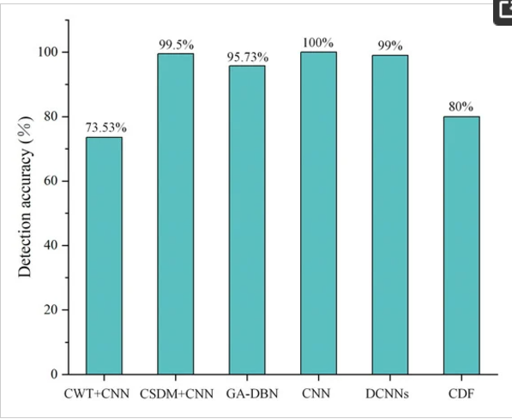
3.5 Summary
Future defect detection technology :
The thermal image is preprocessed
↓
Using deep learning models
↓
Extract features related to defects
↓
Automatic analysis of results

Slide 19
Electronic Industry
04

Slide 20
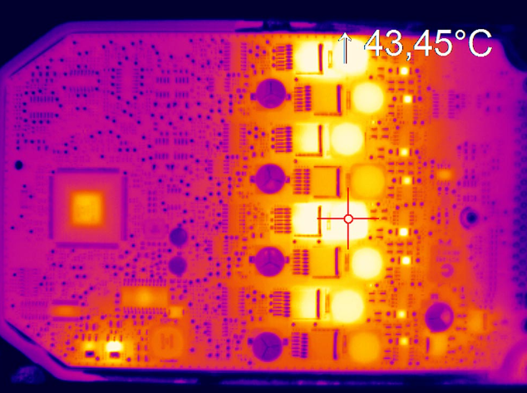
4.1 Intruduction
Development of IRT in the field of electronics
1. Primary territories
Semiconductor wafer production：
Chip，PCBs，Weld，Others.
2.Application purpose
Narrow and reduce production defects.

Slide 21
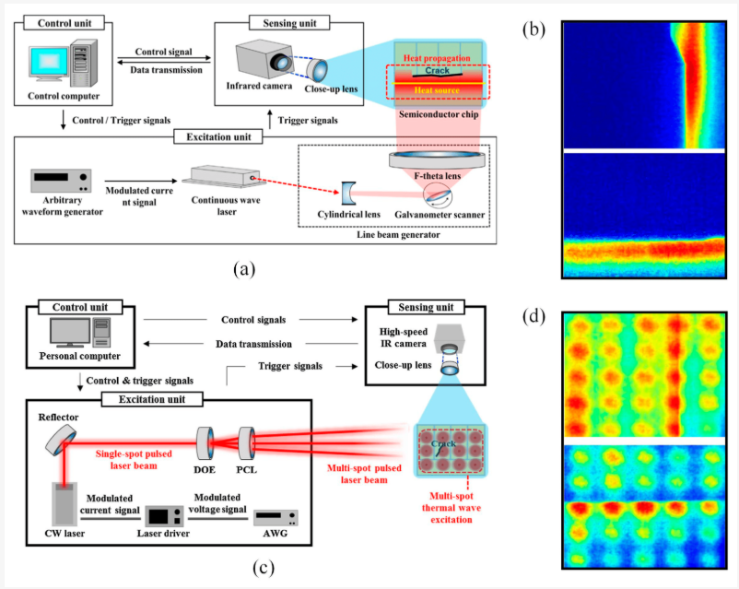
4.2 Chip
Schematic representations of two distinct laser-based thermographic inspection methods:
(a) line laser lock-in thermography system
(b) corresponding thermograms of vertically oriented crack chips and horizontally oriented crack chips within this system ；
(c) multi-point laser lock-in thermography system ；
(d) corresponding thermograms of vertically oriented crack chips and horizontally oriented crack chips within this system].

Slide 22
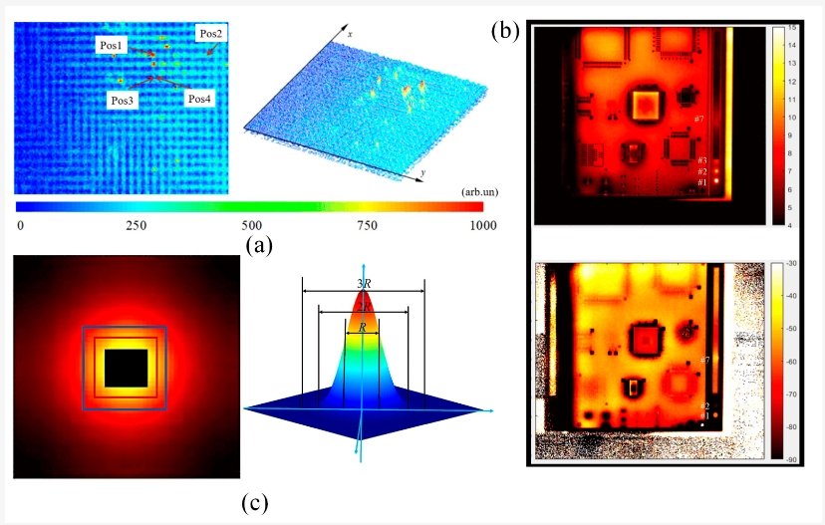
4.3 PCBs
IRT in PCBs :
(a) 2D and 3D views of transient amplitude images ;
(b) amplitude and phase images in lock-in thermography ;
(c) defective and non-defective reference regions

Slide 23
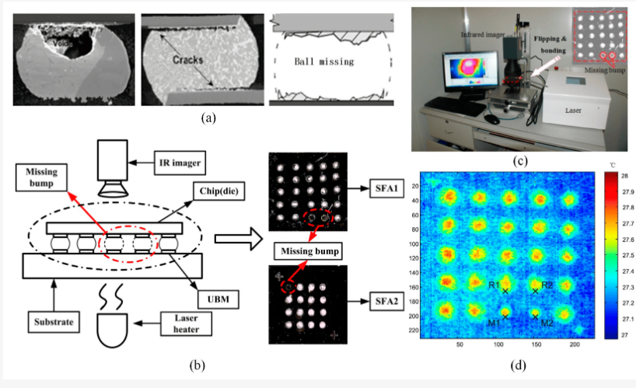
4.4 Weld
Schematic diagram of welding defect detection: types of weld defects：
(a) ,(b) schematic of experimental setup and distribution of welds in test samples ;
(c) experimental setup and distribution diagram;
(d) infrared thermal images of weld defects

Slide 24
Outlooks
05

Slide 25
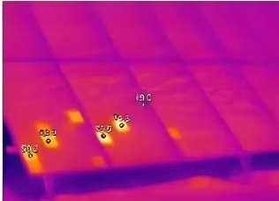
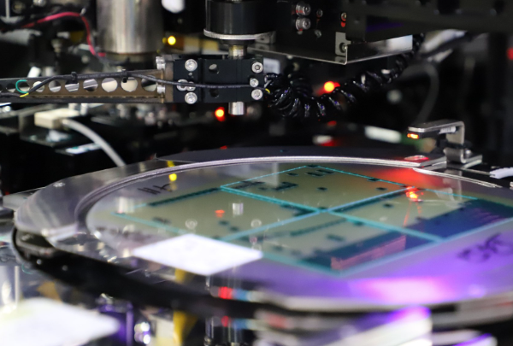

Future development
Widespread adoption in electronics manufacturing
Improvements in PV panels
Seamless integration with AI

Slide 26
THANKS
Presenter: Jung Wook

